Slide 1
Bayesian Network (BN)

Slide 2
Daftar Isi
Pendahuluan
BN Construction
BN Inference
BN Applications
BN Learning
Continuous BN

Slide 3
1. Pendahuluan

Slide 4
Pengantar Bayesian Network (Belief Network)
Jaringan yang dibentuk berdasarkan Hukum Bayes
Menyatakan keterkaitan antar kejadian acak
Karena acak, tiap kejadian dinyatakan dengan probabilitas.
Sehingga disebut dengan graphical probabilitas model.
Node pada graph menyatakan kejadian
Arc pada graph menyatakan keterkaitan antar kejadian
Tiap arc memiliki arah yang menyatakan kausalitas (sebab-akibat)

Slide 5

Pengertian dasar probabilitas
Keterkaitan menyatakan dependency
Independen → tanpa keterkaitan → tanpa arc
A dan B independen
↔ $P\left(A and B\right)=P\left(A\right)P\left(B\right)$
↔ $P\left(A | B\right)=P\left(A\right)$
$P\left(A and B\right)=P\left(AB\right)$ → joint probability
$P\left(A\right)$ → marginal probability
$P\left(A | B\right)$→ conditional probability

Slide 6
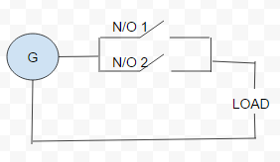
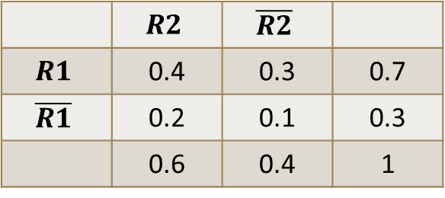
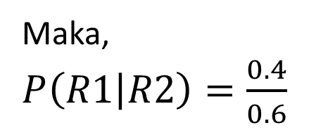
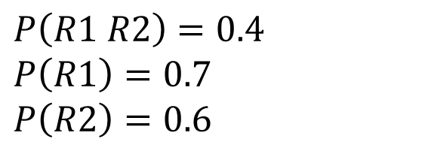
Contoh 1
$P\left(R1 R2\right)=0.4$
$P\left(R1\right)=0.7$
$P\left(R2\right)=0.6$
Maka,
$P\left(R1 | R2\right)=\frac{0.4}{0.6}$
Probabilitas gabungan yang menyatakan kondisi relay
Joint Probability Table
 | $$R2$$ | $$\overline{R2}$$
$$R1$$ | 0.4 | 0.3 | 0.7
$$\overline{R1}$$ | 0.2 | 0.1 | 0.3
 | 0.6 | 0.4 | 1

Slide 7

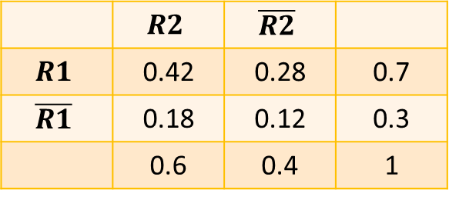
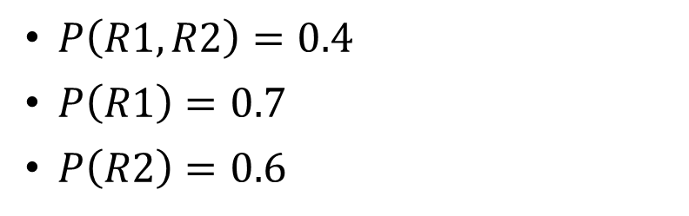
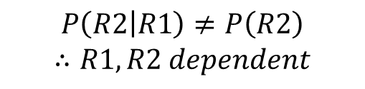
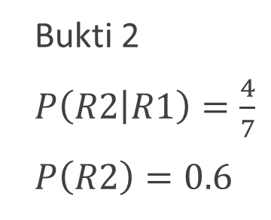
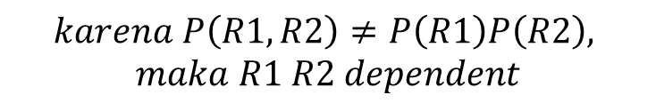
Contoh 1
Apakah relay 1 dan 2 independen?
Bukti 1
$P\left(R1,R2\right)=0.4$
$P\left(R1\right)=0.7$
$P\left(R2\right)=0.6$
$$karena P\left(R1,R2\right)≠P\left(R1\right)P\left(R2\right),$$
$$maka R1 R2 dependent$$
$$P\left(R1\right) P\left(R2\right)=0.42$$
Bukti 2
$P\left(R2 | R1\right)=\frac{4}{7}$
$P\left(R2\right)=0.6$
Supaya independen, nilainya harus
$$P\left(R2 | R1\right)≠P\left(R2\right)$$
$$∴R1,R2 dependent$$
 | $$R2$$ | $$\overline{R2}$$
$$R1$$ | 0.42 | 0.28 | 0.7
$$\overline{R1}$$ | 0.18 | 0.12 | 0.3
 | 0.6 | 0.4 | 1

Slide 8
Contoh 1
Seringkali tabel disajikan dalam bentuk Conditional Probability Table (CPT)
R1 | R2 | Prob
T | T | 0.4
T | F | 0.3
F | T | 0.2
F | F | 0.1
Total |  | 1

Slide 9

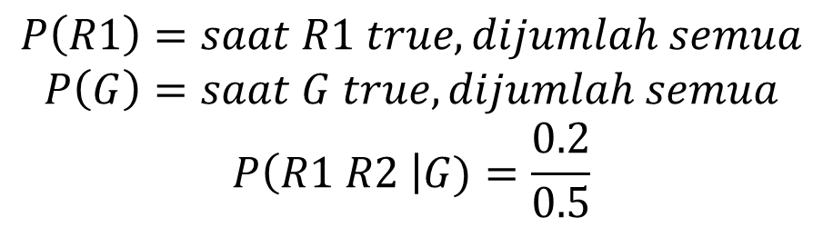
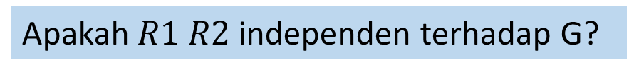
Contoh 1
Bila ditambahkan tentang kejadian G, diperlukan CPT sebagai berikut
R1 | R2 | G | Probabilitas
T | T | T | 0.2 | 0.4
T | T | F | 0.2
T | F | T | 0.15 | 0.3
T | F | F | 0.15
F | T | T | 0.1 | 0.2
F | T | F | 0.1
F | F | T | 0.05 | 0.1
F | F | F | 0.05
Total |  |  | 1
$$P\left(G\right)=0.5$$
$$P\left(R1\right)=saat R1 true, dijumlah semua$$
$$P\left(G\right)=saat G true, dijumlah semua$$
$$P\left(R1 R2 \right|G)=\frac{0.2}{0.5}$$
Apakah $R1 R2$ independen terhadap G?

Slide 10

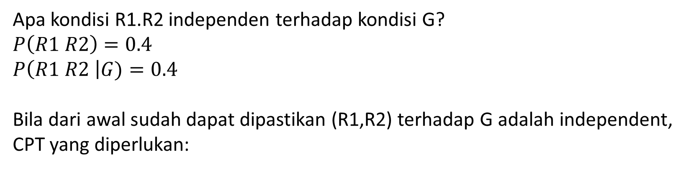
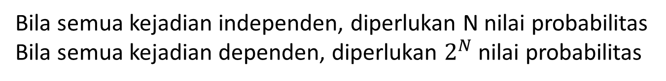
Contoh 1
Apa kondisi R1.R2 independen terhadap kondisi G?
$P\left(R1 R2\right)=0.4$
$P\left(R1 R2 \right|G)=0.4$
Bila dari awal sudah dapat dipastikan (R1,R2) terhadap G adalah independent,
CPT yang diperlukan:
$P\left(R1 R2 G\right)=0.2$
$P\left(R1 R2\right)=0.4$
$P\left(G\right)=0.5$
independent
independent
R1 | R2 | Prob
T | T | 0.4
T | F | 0.3
F | T | 0.2
F | F | 0.1
G | Prob
T | 0.5
F | 0.5
Bila semua kejadian independen, diperlukan N nilai probabilitas
Bila semua kejadian dependen, diperlukan $2^{N}$ nilai probabilitas

Slide 11

Contoh 1
Dapat disimpulkan bahwa G independen terhadap R1 dan R2, sedangkan R1 dependent terhadap R2
Bayesian Network nya:
Anak panah menyatakan dependency
Arah dari anak panah itu sendiri boleh dibolak-balik
P(G) P(R1) P(R2|R1)
G | Prob
T | 0.5
F | 0.5
R1 | Prob
T | 0.7
F | 0.3
R1 | R2 | Prob
T | T | 0.4
T | F | 0.3
F | T | 0.2
F | F | 0.1

Slide 12
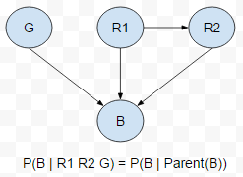
Contoh 1
Bila beban dimasukkan ke Bayesian Network:
G, R1, R2 = Parent(B)
Parent(B) harus diketahui untuk mencari B

Slide 13
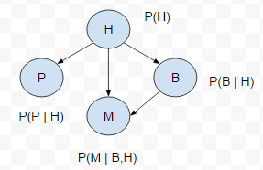
Contoh 2
Ada 4 kejadian : Hujan, Macet, Banjir, Pakai Payung. Buat Bayesian Networknya

Slide 14
Contoh 2
Ada 4 kejadian : Hujan, Macet, Banjir, Pakai Payung. Buat Bayesian Networknya
Membuat Bayesian Network perlu info :
Kejadian-kejadian
Hubungan antar kejadian
Probabilitas tiap-tiap kejadian dengan info parent kejadian tersebut

Slide 15
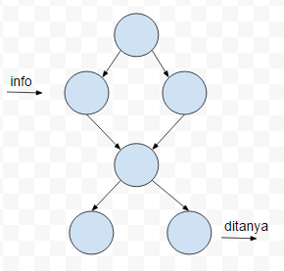
Model Bayesian Network
Dari BN, dapat diperoleh probabilitas tiap kejadian ( dari contoh soal 2, P(M), P(B), P(H), P(P) )
Dari BN, juga dapat diperoleh informasi tentang adanya kejadian tertentu
Contoh:

Slide 16


Hukum Probabilitas dalam BN
Bentuk Umum probabilitas total dengan chain rule:
$$P\left(X1, X2,….XN\right)= \prod_{i}{P(Xi | parents(Xi))}$$
Full Joint Distribution (tanpa memperhatikan struktur jaringan)
memperhatikan struktur jaringan
Karena independen, maka perkalian
A
B
$$P\left(A,B,C\right)=P\left(C | A,B\right)P\left(A\right)P(B)$$
C

Slide 17
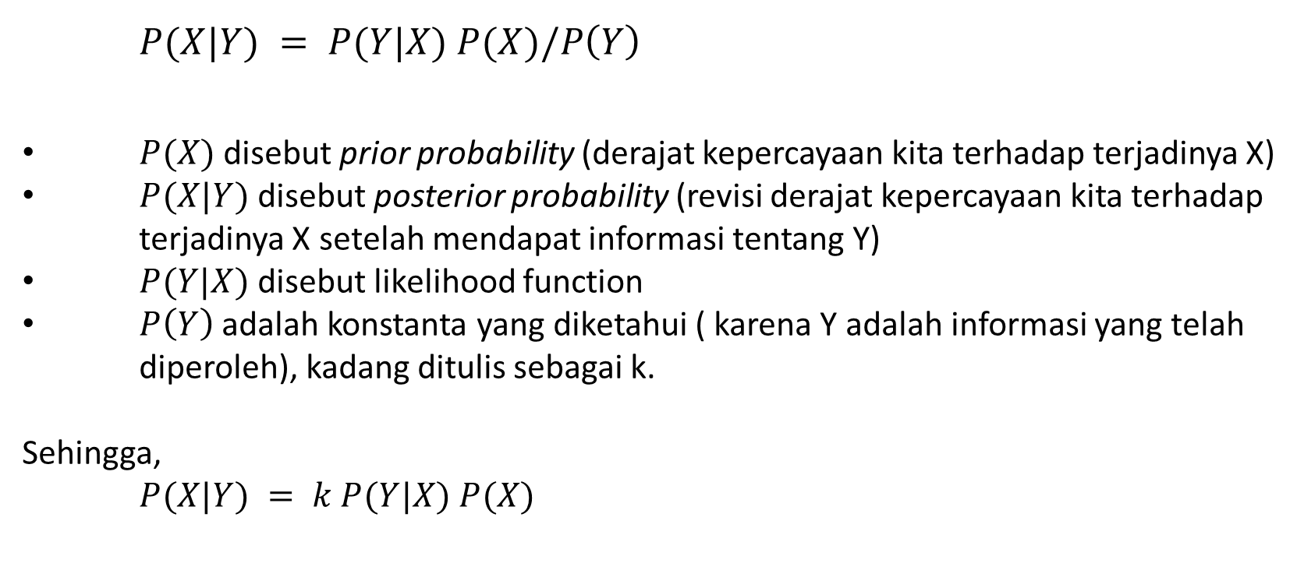
Hukum Bayes dalam BN
$P(X|Y) = P(Y|X) P(X)/P\left(Y\right)$
$P(X)$ disebut prior probability (derajat kepercayaan kita terhadap terjadinya X)
$P(X|Y)$disebut posterior probability (revisi derajat kepercayaan kita terhadap terjadinya X setelah mendapat informasi tentang Y)
$P(Y|X)$disebut likelihood function
$P\left(Y\right)$ adalah konstanta yang diketahui ( karena Y adalah informasi yang telah diperoleh), kadang ditulis sebagai k.
Sehingga,
$P(X|Y) = k P(Y|X) P(X)$

Slide 18
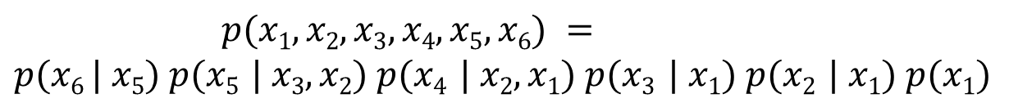
Analisis Bayesian Network
X₁
X₂
X₃
Biasanya dimulai dari leaf (node paling bawah)
X₅
$$p(x1, x2, x3, x4, x5, x6) =$$
$$p(x6 | x5) p(x5 | x3, x2) p(x4 | x2, x1) p(x3 | x1) p(x2 | x1) p(x1)$$
X₄
X₆

Slide 19
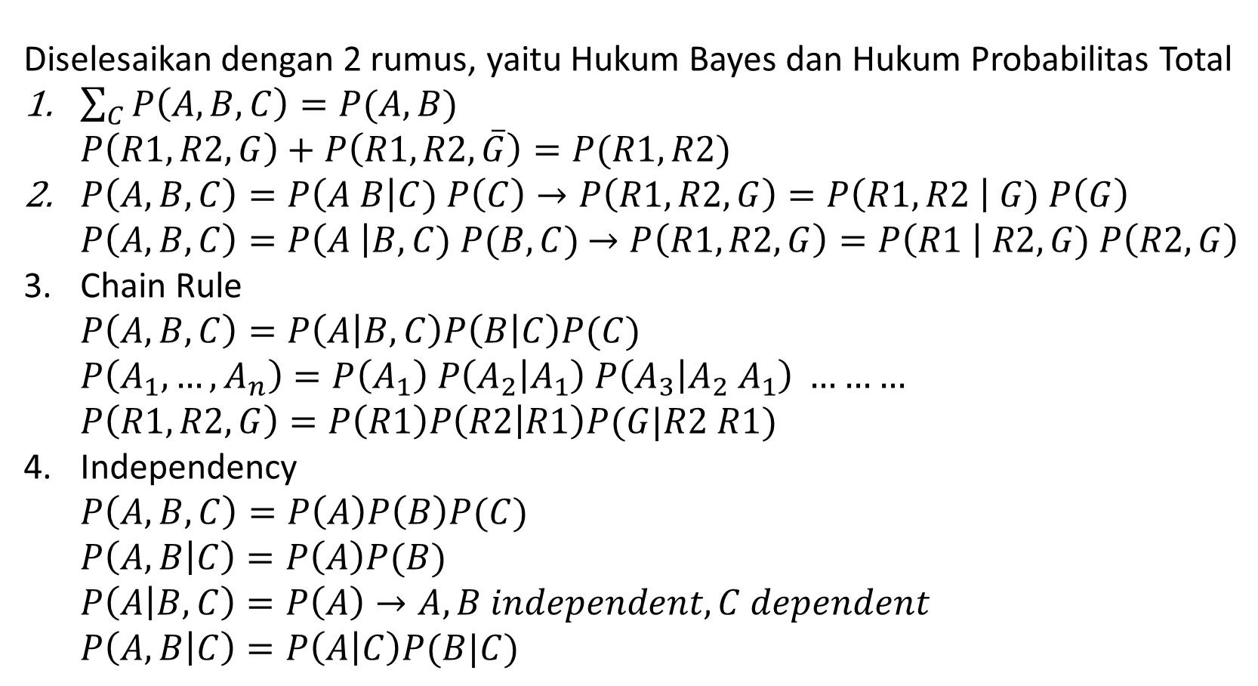
Rumus-rumus untuk Bayesian Network
Diselesaikan dengan 2 rumus, yaitu Hukum Bayes dan Hukum Probabilitas Total
$\sum_{C}{P\left(A,B,C\right)=P(A,B)}$ $P\left(R1,R2,G\right)+P\left(R1,R2,\overline{G}\right)=P(R1,R2)$
$P\left(A,B,C\right)=P\left(A B\right|C) P\left(C\right)→P\left(R1,R2, G\right)=P\left(R1,R2 \right| G) P\left(G\right)$ $P\left(A,B,C\right)=P\left(A \right|B,C) P(B,C)$ $→P\left(R1,R2, G\right)=P\left(R1 \right| R2,G) P\left(R2,G\right)$
Chain Rule $P\left(A,B,C\right)=P\left(A | B,C\right)P\left(B | C\right)P(C)$ $P\left(A_{1},…,A_{n}\right)=P\left(A_{1}\right) P\left(A_{2} | A_{1}\right) P\left(A_{3} | A_{2} A_{1}\right) ………$ $P\left(R1,R2,G\right)=P\left(R1\right)P\left(R2 | R1\right)P(G|R2 R1)$
Independency $P\left(A,B,C\right)=P\left(A\right)P\left(B\right)P(C)$ $P\left(A,B | C\right)=P\left(A\right)P(B)$ $P\left(A | B,C\right)=P\left(A\right)→A,B independent, C dependent$ $P\left(A,B | C\right)=P\left(A | C\right)P(B|C)$

Slide 20
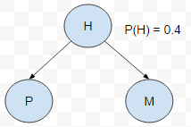
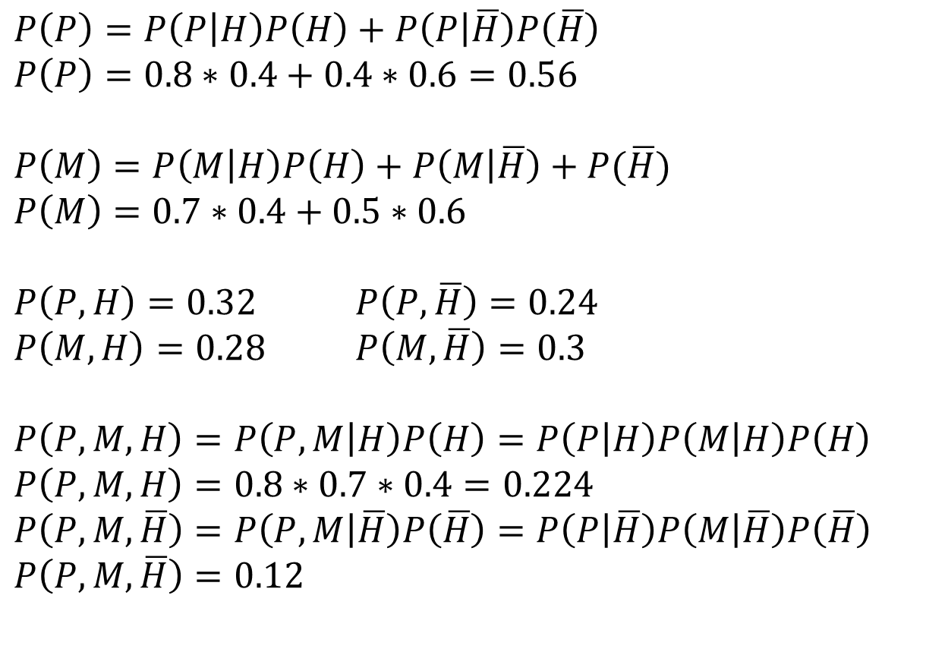
Perhitungan dalam Bayesian Network
$P\left(P\right)=P\left(P | H\right)P\left(H\right)+P\left(P | \overline{H}\right)P\left(\overline{H}\right)$ $P\left(P\right)=0.8∗0.4+0.4∗0.6=0.56$
$P\left(M\right)=P\left(M | H\right)P\left(H\right)+P\left(M | \overline{H}\right)+P(\overline{H})$
$P\left(M\right)=0.7∗0.4+0.5∗0.6$
$P\left(P,H\right)=0.32$ $P\left(P,\overline{H}\right)=0.24$
$P\left(M,H\right)=0.28$ $P\left(M,\overline{H}\right)=0.3$
$P\left(P,M,H\right)=P\left(P,M | H\right)P\left(H\right)=P\left(P | H\right)P\left(M | H\right)P\left(H\right)$ $P\left(P,M,H\right)=0.8∗0.7∗0.4=0.224$
$P\left(P,M,\overline{H}\right)=P\left(P,M | \overline{H}\right)P\left(\overline{H}\right)=P\left(P | \overline{H}\right)P\left(M | \overline{H}\right)P\left(\overline{H}\right)$ $P\left(P,M,\overline{H}\right)=0.12$
P(P|H) P(M|H)
H | M | Prob
T | T | 0.8
T | F | 0.4
F | T | 0.2
F | F | 0.6
H | P | Prob
T | T | 0.7
T | F | 0.5
F | T | 0.3
F | F | 0.5

Slide 21
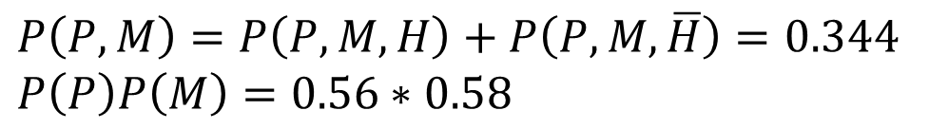
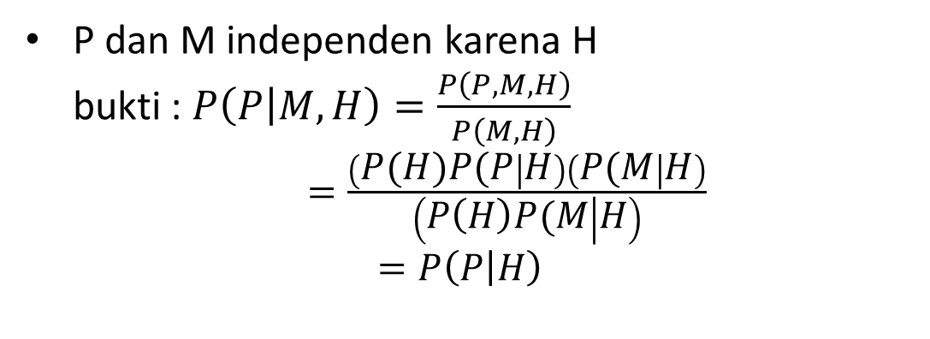
Perhitungan dalam Bayesian Network
$P\left(P,M\right)=P\left(P,M,H\right)+P\left(P,M,\overline{H}\right)=0.344$
$P\left(P\right)P\left(M\right)=0.56∗0.58$
terbukti
P dan M independen karena H bukti : $P\left(P | M,H\right)=\frac{P\left(P,M,H\right)}{P\left(M,H\right)}$ $=\frac{\left(P(H)P(P | H\right)\left(P(M | H\right)}{\left(P\left(H\right)P(M | H\right)}$ $=P\left(P | H\right)$
P(P|H) P(M|H)
H | M | Prob
T | T | 0.8
T | F | 0.4
F | T | 0.2
F | F | 0.6
H | P | Prob
T | T | 0.7
T | F | 0.5
F | T | 0.3
F | F | 0.5
Terbukti M independen H

Slide 22
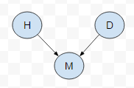

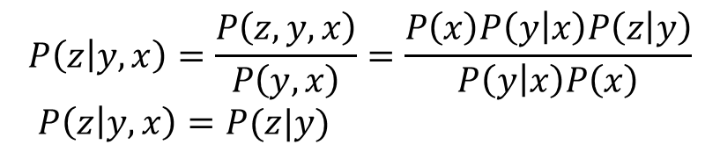
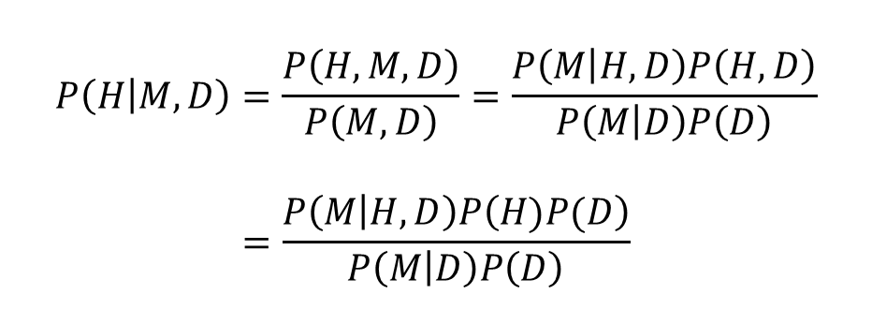
Dependency dalam Bayesian Network
Contoh:
- x,y,z dependent
- Diketahui info tentang y
- x,z?
Contoh:
- Hujan, demo, macet - H,D independen
- Dengan info macet, apakah H,D masih independen?
$$P\left(H | M,D\right)=\frac{P\left(H,M,D\right)}{P\left(M,D\right)}=\frac{P\left(M | H,D\right)P\left(H,D\right)}{P\left(M | D\right)P\left(D\right)}$$
$$=\frac{P\left(M | H,D\right)P\left(H)P(D\right)}{P\left(M | D\right)P\left(D\right)}$$
$$P\left(z | y,x\right)=\frac{P\left(z,y,x\right)}{P\left(y,x\right)}=\frac{P\left(x\right)P\left(y | x\right)P\left(z | y\right)}{P\left(y | x\right)P\left(x\right)}$$
$P\left(z | y,x\right)=P(z|y)$
x independen terhadap z
H dependent D
Tugas: Kerjakan contoh 2 dengan mendefinisikan sendiri angka-angka yang diperlukan

Slide 23
Tugas
Consider the following three expressions for the joint distribution of three random variables X, Y and Z:
P[X, Y, Z] = P[X|Z]P[Y|Z]P[Z]
P[X, Y, Z] = P[X|Z]P[Z|Y]P[Y]
P[X, Y, Z] = P[Y|Z]P[Z|X]P[X]
Use a DAG to show the graphical representation of each of these expressions.
Research shows that tuberculosis and lung cancer can each cause dyspnea (or shortness of breath) and a positive chest X-ray. Bronchitis is another cause of dyspnea. A recent visit to a foreign country could increase the probability of tuberculosis. Smoking can cause both cancer and bronchitis. Create a DAG representing the causal relationships among these variables.
It has been established that smoking causes both bronchitis and lung cancer. Bronchitis and lung cancer both cause fatigue, but only lung cancer can cause a chest X-ray to be positive. If there are no other causal relationships among these variables, create a DAG representing the above causal relationships.

Slide 24
2. BN Construction

Slide 25
Example of BN Construction : Fire Diagnosis
You want to diagnose whether there is a fire in a building
You receive a noisy report about whether everyone is leaving the building
If everyone is leaving, this may have been caused by a fire alarm
If there is a fire alarm, it may have been caused by a fire or by tampering
If there is a fire, there may be smoke

Slide 26
Example of BN Construction : Fire Diagnosis
First you choose the variables. In this case, all are Boolean:
Tampering is true when the alarm has been tampered with
Fire is true when there is a fire
Alarm is true when there is an alarm
Smoke is true when there is smoke
Leaving is true if there are lots of people leaving the building
Report is true if the sensor reports that lots of people are leaving the building
Let’s construct the Bayesian network for this
First, you choose a total ordering of the variables, let’s say: [Tampering; Fire; Alarm; Smoke; Leaving; Report]

Slide 27
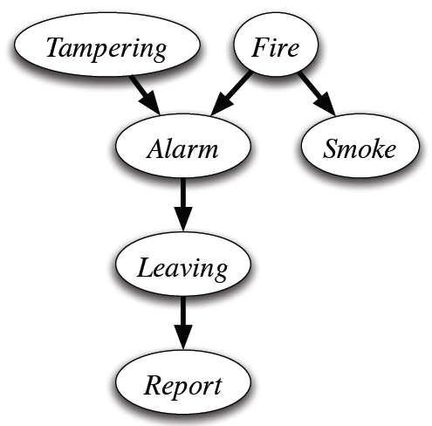
Example of BN Construction : Fire Diagnosis
fire dan tampering adalah unobservable events
permasalahan biasanya adalah bagaimana mengetahui probabilitas unobservable event
$$P(T, F, A, S, L, R) = P(R|L) P (L|A) P (A|T,F) P(S|F) P(F) P(T)$$
$P(T, F, A, S, L, R) = P(T) P (F) P(S|F) P(A|T,F) P(L|A) P(R|L$)

Slide 28
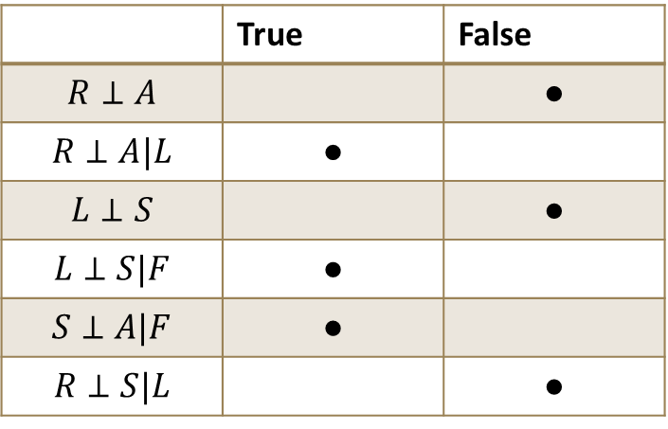
Dependency
 | True | False
$$R⊥A$$ |  | ●
$$R⊥A|L$$ | ●
$$L⊥S$$ |  | ●
$$L⊥S|F$$ | ●
$$S⊥A|F$$ | ●
$$R⊥S|L$$ |  | ●
General rule of thumb:
A known variable makes everything below that variable independent from everything above that variable.

Slide 29
Example of BN Construction: Alarm
I’m at work, neighbor John calls to say my alarm is ringing, but neighbor Mary doesn’t call. Sometimes it’s set off by minor earthquakes. Is there a burglar?
Variables: Burglar, Earthquake, Alarm, JohnCalls, MaryCalls
Network topology reflects “causal” knowledge:
A burglar can set the alarm off
An earthquake can set the alarm off
The alarm can cause Mary to call
The alarm can cause John to call

Slide 30
Example of BN Construction : Alarm
Consider the following 5 binary variables:
B = a burglary occurs at your house
E = an earthquake occurs at your house
A = the alarm goes off
J = John calls to report the alarm
M = Mary calls to report the alarm
We can use the full joint distribution to answer this question
Requires 2⁵ = 32 probabilities
Can we use prior domain knowledge to come up with a Bayesian network that requires fewer probabilities?
Order the variables in terms of causality (may be a partial order)
e.g., {E, B} -> {A} -> {J, M}

Slide 31
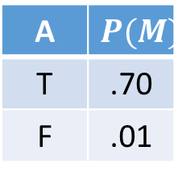
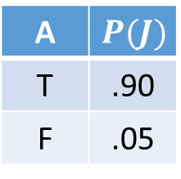
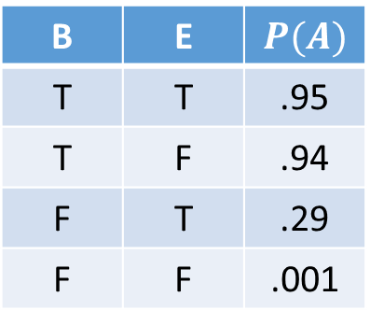
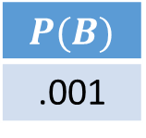
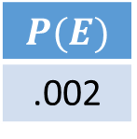
The Resulting Bayesian Network
$$P(B)$$
.001
$$P(E)$$
.002
B | E | $$P(A)$$
T | T | .95
T | F | .94
F | T | .29
F | F | .001
Requires = 10 probabilities!
A | $$P(M)$$
T | .70
F | .01
A | $$P(J)$$
T | .90
F | .05

Slide 32
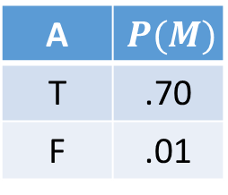
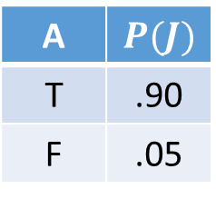
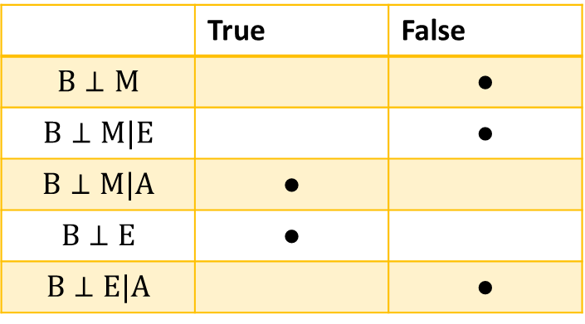
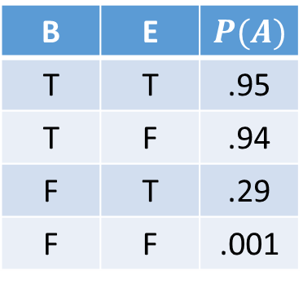
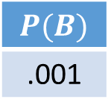
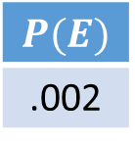
Dependensi
$$P(B)$$
.001
$$P(E)$$
.002
 | True | False
$$B⊥M$$ |  | ●
$$B⊥M|E$$ |  | ●
$$B⊥M|A$$ | ●
$$B⊥E$$ | ●
$$B⊥E|A$$ |  | ●
B | E | $$P(A)$$
T | T | .95
T | F | .94
F | T | .29
F | F | .001
A | $$P(M)$$
T | .70
F | .01
A | $$P(J)$$
T | .90
F | .05

Slide 33
3. BN Inference

Slide 34
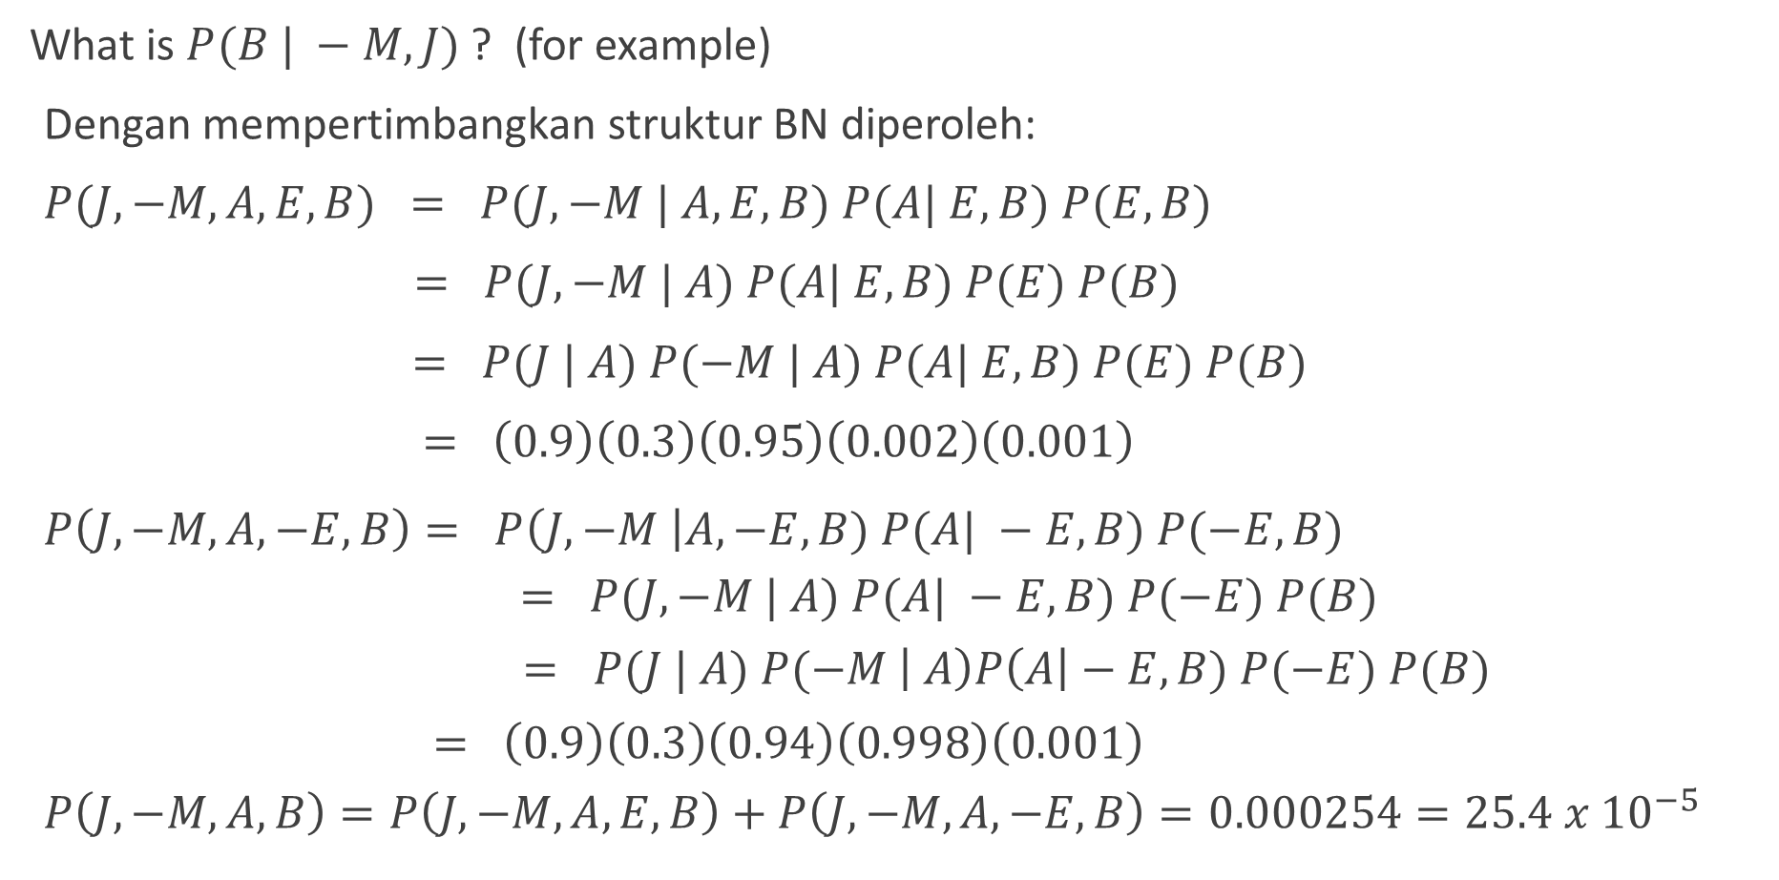
Analysing Bayesian Network: Enumeration
What is $P(B | −M, J)$? (for example)
Dengan mempertimbangkan struktur BN diperoleh:
$P(J, −M, A, E, B) = P(J, −M | A, E, B) P(A| E, B) P(E, B)$
$= P(J, −M | A) P(A| E, B) P(E) P(B)$
$= P(J | A) P(−M | A) P(A| E, B) P(E) P(B)$
$= \left(0.9\right)\left(0.3\right)\left(0.95\right)\left(0.002\right)\left(0.001\right)$
$P\left(J,−M,A,−E,B\right)= P\left(J, −M \right|A, −E, B) P(A| −E, B) P(−E, B)$
$$= P(J, −M | A) P(A| −E, B) P(−E) P(B)$$
$$= P(J | A) P(−M \left| A\right)P\left(A\right|−E, B) P(−E) P(B)$$
$$= \left(0.9\right)\left(0.3\right)\left(0.94\right)\left(0.998\right)\left(0.001\right)$$
$$P\left(J,−M,A,B\right)=P\left(J,−M,A,E,B\right)+P\left(J,−M,A,−E,B\right)=0.000254=25.4 x {10}^{−5}$$

Slide 35
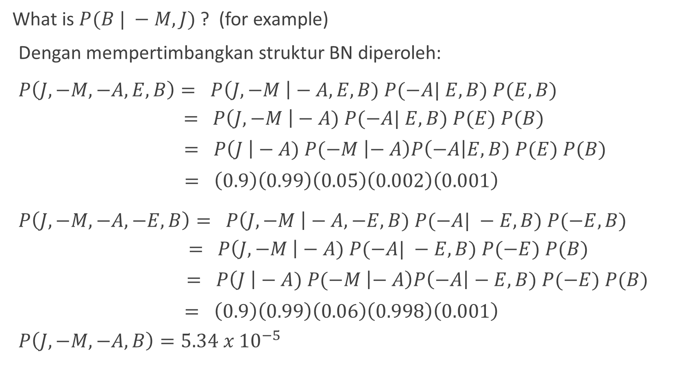
Analysing Bayesian Network: Enumeration
What is $P(B | −M, J)$? (for example)
Dengan mempertimbangkan struktur BN diperoleh:
$P\left(J,−M,−A,E,B\right)= P\left(J, −M \right|−A, E, B) P(−A| E, B) P(E, B)$
$$= P\left(J, −M \right|−A) P(−A| E, B) P(E) P(B)$$
$$= P\left(J \right|−A) P(−M \left|− A\right)P\left(−A\right|E, B) P(E) P(B)$$
$$= \left(0.9\right)\left(0.99\right)\left(0.05\right)\left(0.002\right)\left(0.001\right)$$
$P\left(J,−M,−A,−E,B\right)= P\left(J, −M \right|−A, −E, B) P(−A| −E, B) P(−E, B)$
$$= P\left(J, −M \right|−A) P(−A| −E, B) P(−E) P(B)$$
$$= P\left(J \right|−A) P(−M \left|− A\right)P\left(−A\right|−E, B) P(−E) P(B)$$
$$= \left(0.9\right)\left(0.99\right)\left(0.06\right)\left(0.998\right)\left(0.001\right)$$
$$P\left(J,−M,−A,B\right)=5.34 x {10}^{−5}$$

Slide 36
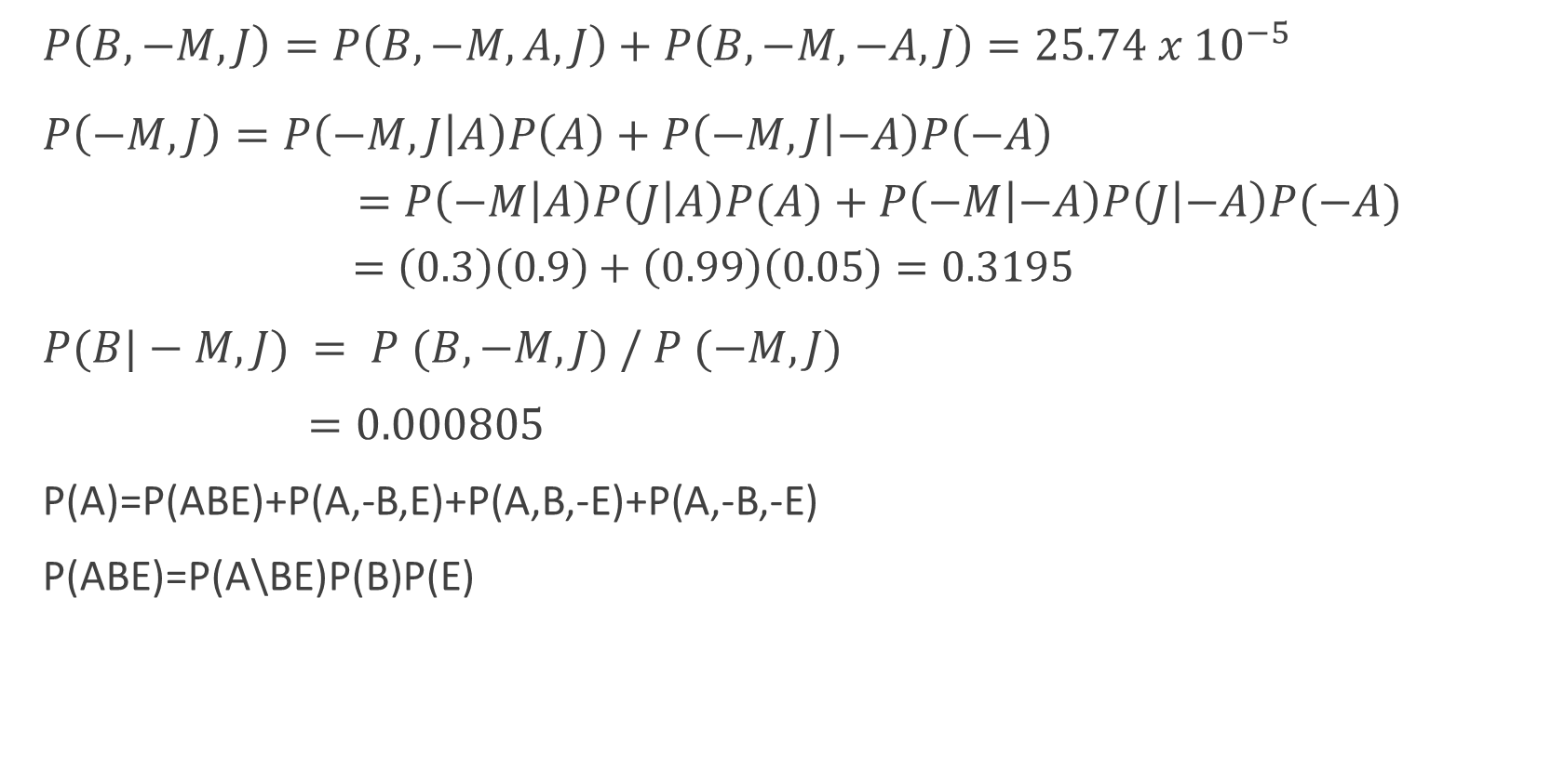
Analysing Bayesian Network: Enumeration
$P\left(B,−M,J\right)=P\left(B,−M,A,J\right)+P\left(B,−M,−A,J\right)=25.74 x {10}^{−5}$
$P\left(−M,J\right)=P\left(−M,J | A\right)P\left(A\right)+P\left(−M,J | −A\right)P\left(−A\right)$ $=P\left(−M | A\right)P\left(J | A\right)P(A)+P\left(−M | −A\right)P\left(J | −A\right)P(−A)$ $=\left(0.3\right)\left(0.9\right)+\left(0.99\right)\left(0.05\right)=0.3195$
$P(B|−M,J) = P (B,−M,J) / P (−M,J)$
$=0.000805$
P(A)=P(ABE)+P(A,-B,E)+P(A,B,-E)+P(A,-B,-E)
P(ABE)=P(A\BE)P(B)P(E)

Slide 37


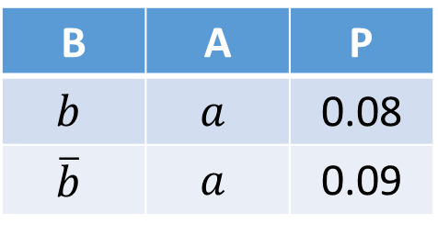
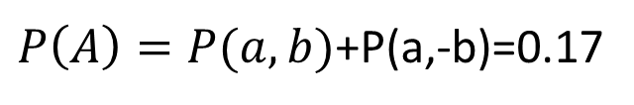
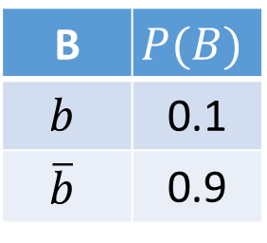


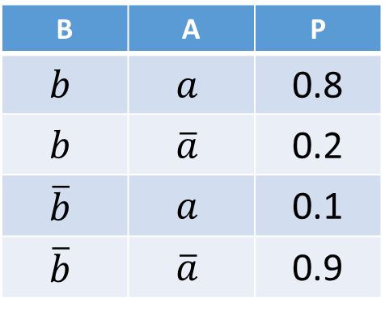
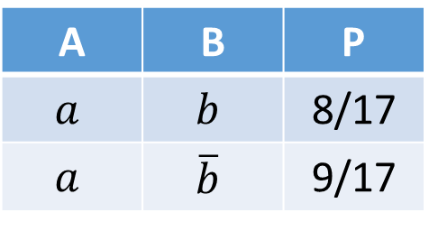

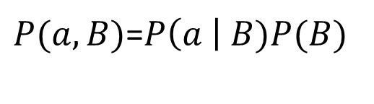
Variable Elimination → Bayes Rule
Start / Select
Join on B
Normalize
$$P(B)$$
B | $$P(B)$$
$$b$$ | 0.1
$$\overline{b}$$ | 0.9
$P(a,B)$=$P\left(a \right| B)P(B)$
$$P\left(B | a\right)=P(a,B)/P(a)$$
B | A | P
$$b$$ | $$a$$ | 0.08
$$\overline{b}$$ | $$a$$ | 0.09
A | B | P
$$a$$ | $$b$$ | 8/17
$$a$$ | $$\overline{b}$$ | 9/17
$$P\left(A \right| B) →P\left(a \right| B)$$
B | A | P
$$b$$ | $$a$$ | 0.8
$$b$$ | $$\overline{a}$$ | 0.2
$$\overline{b}$$ | $$a$$ | 0.1
$$\overline{b}$$ | $$\overline{a}$$ | 0.9
$P\left(A\right)=P(a,b)$+P(a,-b)=0.17

Slide 38



Alarm Example
$P\left(B | j,−m\right)∝P(B,j,−m)$
$P\left(B\right)$ $P(E)$ $P(A|B,E)$ $P(j|A)$ $P(−m|A)$
Choose A
$P\left(A | B,E\right)$ $P(j|A)$ $P(j,−m,A|B,E)$ $P(j,−m|B,E)$ $P(−m|A)$

Slide 39






Alarm Example
$$P(A|B,E)$$
$$P(j,−M,A|B,E)$$
B | E | P(A) | P(-A)
T | T | 0.95 | 0.05
T | F | 0.94 | 0.06
F | T | 0.29 | 0.71
F | F | 0.001 | 0.999
B | E | P
T | T | 0.2565
T | F | 0.2538
F | T | 0.0783
F | F | 0.00027
$$P(j,−M|B,E)$$
B | E | P
T | T | 0.258975
T | F | 0.25677
F | T | 0.113445
F | F | 0.0497205
$$P(J|A)$$
$$P(−M|A)$$
$$P(j,−M,−A|B,E)$$
A | P(J)
T | 0.9
F | 0.05
A | P(-M)
T | 0.3
F | 0.99
B | E | P
T | T | 0.002475
T | F | 0.00297
F | T | 0.035145
F | F | 0.0494505

Slide 40








Alarm Example
$P\left(B\right)$ $P(E)$ $P(j,−m|B,E)$
Choose E
$P(E)$
$P\left(j,−m | B,E\right)$
$$P(j,−m,E|B)$$
$$P(j,−m|B)$$
$$P(E)$$
P(E)
0.002
$$P(j,−m,E|B)$$
$$P(j,−m,−E|B)$$
$$P(j,−m|B)$$
B | P
T | 0.00051795
T
F | 0.00022689
F
B | P
T
T
F
F
B | P
T
T
F
F
$$P(j,−m|B,E)$$
B | E | P
T | T | 0.258975
T | F | 0.25677
F | T | 0.113445
F | F | 0.0497205

Slide 41



Alarm Example
$P\left(B\right)$ $P(j,−m|B)$
Finish with B
$P(B)$
$P\left(j,−m | B\right)$
$$P(j,−m,B)$$
$$P(B|j,−m)$$
normalize
Lanjutkan dan cocokkan hasilnya dengan metode enumerasi!

Slide 42
Tree-Structured Bayesian Network
Dapat menggunakan message passing algorithm
$P(A, B, C, D, E, F, G) =$

Slide 43

Tree-Structured Bayesian Network
$P(A,B,C,D,E,F,G) =P\left(A | B\right)P\left(C | B\right)P\left(F | E\right)P\left(G | E\right)P\left(B | D\right)P\left(E | D\right)P(D)$

Slide 44







Tree-Structured Bayesian Network
$$P(D)$$
.50
D | $$P(B)$$
T | .70
F | .30
D | $$P(E)$$
T | .60
F | .40
B | $$P(A)$$
T | .70
F | .30
E | $$P(G)$$
T | .60
F | .40
B | $$P(C)$$
T | .40
F | .60
E | $$P(F)$$
T | .50
F | .50

Slide 45

Contoh
Diperoleh informasi bahwa $C$ dan $G$ terjadi.
Akan dihitung $P(A|C,G)$

Slide 46

Contoh
Kalkulasi langsung:
$P(A|C,G)$ = $\sum_{bdef}{P(A,B,D,E,F | C,G)}$

Slide 47

Contoh
Reordering:
$$\sum_{B}{P\left(A | B\right)}\sum_{D}{P\left(B | D,C\right)}\sum_{E}{P\left(D | E\right)}\sum_{f}{P(E,F |G)}$$

Slide 48


Contoh
Reordering:
$$\sum_{B}{P\left(A | B\right)}\sum_{D}{P\left(B | D,C\right)}\sum_{E}{P\left(D | E\right)}\sum_{F}{P(E,F |G)}$$
$$P(E|G)$$

Slide 49



Contoh Soal
Reordering:
$$\sum_{B}{P\left(A | B\right)}\sum_{D}{P\left(B | D,C\right)}\sum_{E}{P\left(D | E\right)}\sum_{F}{P(E,F |G)}$$
$$P\left(e,d\right)=P\left(e | d\right)P\left(d\right)=\left(0.6\right)\left(0.5\right)=0.3$$
$$P\left(e,−d\right)=P\left(e | −d\right)P\left(−d\right)=\left(0.4\right)\left(0.5\right)=0.2$$
$$P\left(e\right)=\sum_{d}{P\left(e,d\right)=P\left(e,d\right)+P\left(e,−d\right)=}0.5$$
$$P\left(e,f | g\right)=\frac{P\left(e,f,g\right)}{P\left(g\right)}$$
$$P\left(e,f,g\right)=P\left(f,g | e\right)P\left(e\right)$$
$$P\left(e,f,g\right)=P\left(f | e\right)P\left(g | e\right)P\left(e\right)=\left(0.5\right)\left(0.6\right)\left(0.5\right)=0.15$$
$$P\left(g,e\right)=P\left(g | e\right)P\left(e\right)=\left(0.6\right)\left(0.5\right)=0.3$$
$$P\left(−g,e\right)=P\left(−g | e\right)P\left(e\right)=\left(0.4\right)\left(0.5\right)=0.2$$
$$P\left(e\right)=\sum_{g}{P\left(e,g\right)=P\left(e,g\right)+P\left(e,−g\right)}=0.5$$
$P\left(e,−f,g\right)=P\left(−f,g | e\right)P(e)$
$P\left(e,−f,g\right)=P\left(−f | e\right)P\left(g | e\right)P\left(e\right)$ $P\left(e,−f,g\right)=\left(0.5\right)\left(0.6\right)\left(0.5\right)=0.15$
$$P\left(e,−f | g\right)=\frac{P\left(e,−f,g\right)}{P\left(g\right)}=\frac{0.15}{0.5}=0.3$$
$$P\left(e,f | g\right)=\frac{P\left(e,f,g\right)}{P\left(g\right)}=\frac{0.15}{0.5}=0.3$$
$$P\left(e | g\right)=P\left(e,f | g\right)+P\left(e,−f | g\right)=0.6$$

Slide 50



Contoh
$$P\left(d | e\right)=\frac{P\left(e | d\right)P\left(d\right)}{P\left(e\right)}=\frac{\left(0.6\right)\left(0.5\right)}{0.5}=0.6 \\ P\left(d | −e\right)=\frac{P\left(−e | d\right)P\left(d\right)}{P\left(−e\right)}=\frac{\left(0.4\right)\left(0.5\right)}{0.5}=0.4$$
$$P\left(d | g\right)=P\left(d | e\right)P\left(e | g\right)+P\left(d | −e\right)P(−e|g)$$
$=\left(0.6\right)\left(0.6\right)+\left(0.4\right)\left(0.4\right)=0.58$
Reordering:
$$\sum_{B}{P\left(A | B\right)}\sum_{D}{P\left(B | D,C\right)}\sum_{E}{P\left(D | E\right)}P(E|G)$$
$$P(D|G)$$

Slide 51



Contoh
Reordering:
$$\sum_{B}{P\left(A | B\right)}\sum_{D}{P\left(B | D,C\right)}P(D|G)$$
$$P(B|C,G)$$
$$P\left(b | c,g\right)=P\left(b | d,c\right)P\left(d | g\right)+P\left(b | −d,c\right)P\left(−d | g\right)$$
$=\left(0.609\right)\left(0.58\right)+\left(0.222\right)\left(0.42\right)=0.44646$

Slide 52

Contoh Soal
$$P\left(c | d\right)=P\left(c | b\right)P\left(b | d\right)+P\left(c | −b\right)P\left(−b | d\right)=\left(0.4\right)\left(0.7\right)+\left(0.6\right)\left(0.3\right)=0.46$$
$$P\left(c | −d\right)=P\left(c | b\right)P\left(b | −d\right)+P\left(c | −b\right)P\left(−b | −d\right)=\left(0.4\right)\left(0.3\right)+\left(0.6\right)\left(0.7 \right)=0.54$$
$$P\left(d,c\right)=P\left(c | d\right)P\left(d\right)=\left(0.46\right)\left(0.5\right)=0.23$$
$$P\left(−d,c\right)=P\left(c | −d\right)P\left(−d\right)=\left(0.54\right)\left(0.5\right)=0.27$$
$$P\left(b,d,c\right)=P\left(b\right)P\left(d | b\right)P\left(c | d,b\right)=P\left(b | d\right)P\left(d\right)P\left(c | b\right)=\left(0.7\right)\left(0.5\right)\left(0.4\right)=0.14$$
$$P\left(b,−d,c\right)=P\left(b\right)P\left(−d | b\right)P\left(c | −d,b\right)=P\left(b | −d\right)P\left(−d\right)P\left(c | b\right)=\left(0.3\right)\left(0.5\right)\left(0.4\right)=0.06$$
$$P\left(b | d,c\right)=\frac{P\left(b,d,c\right)}{P\left(d,c\right)}=\frac{0.14}{0.23}=0.609$$
$$P\left(b | −d,c\right)=\frac{P\left(b,−d,c\right)}{P\left(−d,c\right)}=\frac{0.06}{0.27}=0.222$$

Slide 53



Contoh
Reordering:
$$\sum_{B}{P\left(A | B\right)}P(B|C,G)$$
$$P\left(A | C,G\right)$$
$$P\left(a | c,g\right)=P\left(a | b\right)P\left(b | c,g\right)+P\left(a | −b\right)P\left(−b | c,g\right)$$
$=\left(0.7\right)\left(0.44646\right)+\left(0.3\right)\left(0.55354\right)=0.478584$

Slide 54
Tugas
Untuk kasus alarm:
Hitung probabilitas terjadi earthquake bila diinformasikan Mary dan John keduanya menelepon
Untuk kasus BN Tree Structure:
Hitung probabilitasnya F terjadi bila diinfokan G terjadi
Idem, bila B dan G terjadi

Slide 55
Message Passing Algorithm (Pearl)
Pearl, 1988;
Untuk BN yang berbentuk Polytree
Tentukan 1 node (sembarang) sebagai root
Jadwalkan message passing dalam dua tahap
nodes menyampaikan message ke root
Root mendistribusikan messages ke semua leaves
Waktu komputasi sebanding dengan banyaknya node O(n)

Slide 56
Contoh Operasional Algoritma MP

Slide 57
1
2
3
4

Slide 58
BN yang bukan Polytree
D
B
E
A
C
F
G

Slide 59
BN yang bukan Polytree
D
B
E
A
C
F
G
“cluster” beberapa nodes menjadi satu untuk menghasilkan polytree

Slide 60
Junction Tree
D
B, E
A
C
F
G

Slide 61
4. BN Sample Application

Slide 62
Example from Medical Diagnostics
Visit to Asia
Smoking
Patient Information
Tuberculosis
Lung Cancer
Bronchitis
Medical Difficulties
Tuberculosis
or Cancer
XRay Result
Dyspnea
Diagnostic Tests
Network represents a knowledge structure that models the relationship between medical difficulties, their causes and effects, patient information and diagnostic tests

Slide 63
Example from Medical Diagnostics
Tuber
Present
Present
Absent
Absent
Lung Can
Present
Absent
Present
Absent
Tub or Can
True
True
True
False
Visit to Asia
Smoking
Patient Information
Tuberculosis
Lung Cancer
Bronchitis
Medical Difficulties
Dyspnea
Tuberculosis
or Cancer
Tub or Can
True
True
False
False
Bronchitis
Present
Absent
Present
Absent
Present
0.90
0.70
0.80
0.10
Absent
0.l0
0.30
0.20
0.90
XRay Result
Dyspnea
Diagnostic Tests
Relationship knowledge is modeled by deterministic functions, logic and conditional probability distributions

Slide 64
Example from Medical Diagnostics
Propagation algorithm processes relationship information to provide an unconditional or marginal probability distribution for each node
The unconditional or marginal probability distribution is frequently called the belief function of that node

Slide 65
Example from Medical Diagnostics
As a finding is entered, the propagation algorithm updates the beliefs attached to each relevant node in the network
Interviewing the patient produces the information that “Visit to Asia” is “Visit”
This finding propagates through the network and the belief functions of several nodes are updated

Slide 66
Example from Medical Diagnostics
Further interviewing of the patient produces the finding “Smoking” is “Smoker”
This information propagates through the network

Slide 67
Example from Medical Diagnostics
Finished with interviewing the patient, the physician begins the examination
The physician now moves to specific diagnostic tests such as an X-Ray, which results in a “Normal” finding which propagates through the network
Note that the information from this finding propagates backward and forward through the arcs

Slide 68
Example from Medical Diagnostics
The physician also determines that the patient is having difficulty breathing, the finding “Present” is entered for “Dyspnea” and is propagated through the network
The doctor might now conclude that the patient has bronchitis and does not have tuberculosis or lung cancer

Slide 69
5. BN Learning

Slide 70
Building BN Structures by Learning
Problem
Domain
Probability
Elicitor
Bayesian
Network
Expert
Knowledge
Problem
Domain
Learning
Algorithm
Bayesian
Network
Training
Data
Problem
Domain
Learning
Algorithm
Bayesian
Network
Expert
Knowledge
Training
Data

Slide 71
Propagation Example
“The impact of each new piece of evidence is
viewed as a perturbation that propagates through
the network via message-passing between
neighboring variables . . .” (Pearl, 1988, p 143`
Data
Data
The example above requires five time periods to reach equilibrium after the introduction of data (Pearl, 1988, p 174)

Slide 72
Original Network

Slide 73
Learned Network with 1000 Cases
Missing Arcs: 2
Added Arcs: 0
Arcs Misdirected: 5
Arcs Unspecified: 3

Slide 74
Learned Network with 10,000 Cases
Missing Arcs: 1
Added Arcs: 1
Arcs Misdirected: 4

Slide 75
6. Continuous BN

Slide 76

Continuous Variables Example
Data from three sensors can be fused to gain information on relevant variables

Slide 77

Continuous Variables Example
Entering values for the three discrete random variables shifts the sensor mean values

Slide 78

Continuous Variables Example
A defective filter has a strong impact on the light penetrability and metal emissions sensors

Slide 79

Continuous Variables Example
What can we learn about the three state variables given sensor outputs?

Slide 80

Continuous Variables Example
A light penetrability reading that is 3 sigma low is a strong indicator of a defective filter

Slide 81
Aplikasi Populer Saat Ini….
Machine Learning
Artificial Intelligent
Intelligent Control

